Slide 1
Identification using Cancelable Biometrics and Deep Learning

Slide 2
Presented By
Shahad Alghamdi
Sara Aldawsari
Deema Almalki
Hatoon Abdullatif
Wed Alotaibi

Slide 3
Table of Contents
01
02
03
04
Introduction
Background Information & Related Work
System Analysis
System Design

Slide 4
01
Introduction

Slide 5
Introduction contains a :
Problem Statement & Significance
Proposed Solution & Objectives
Project Domain & Limitations

Slide 6

Introduction
Personal identification can be achieved using biometrics recognition which has emerged as a reliable approach for automated human identification and is attracting significant attention from the researchers in multifaceted disciplines.
we propose the development of a reliable personal identification system which is based on cancelable biometrics and distributed deep learning.

Slide 7
Problem Statement & Significance
The concept of the biometric is the automated recognition of human individuals based on their biological and behavioral traits. Because sometimes People forgetting their passwords all the time even their personal identifications.
If they lost it and it takes space and sometimes you will have to pay for you belongs to get it back or to get new ones.
To Secure personal identification and biomatrices: fingerprint and face ID are safer than password.
It’s not easy to hack and if it hacked, we can cancelable Biometrics and change the encryption of the biometric.

Slide 8
Problem Statement & Significance
We will use Personal identification using cancelable biometrics and distributed deep learning to solve this problem by using the technic face identification (face id) to make people lives easer so they don’t have to remember every password they have and their personal identification will be more secure and safe because of cancelable biometric it has two category biometrics authentication compares data for the person's characteristics to that person's biometric "template" to determine resemblance .
The data stored is then compared to the person's biometric data to be authenticated.

Slide 9
Proposed Solution & Objective
A program that contains the personal information such as (id, license, bank account pin password) so they won’t forget their password or lost their credit card, id and license anymore and in order to open the program you will have to use your face
Aims & Goals:
We will be learning more about biometrics and new programming langue
attach people information in one program that will be secured

Slide 10
Project Domain & Limitation
This program will apply only on Saudi Arabia, and it will be available for all age ranges.

Slide 11
02
Background Information & Related Work

Slide 12
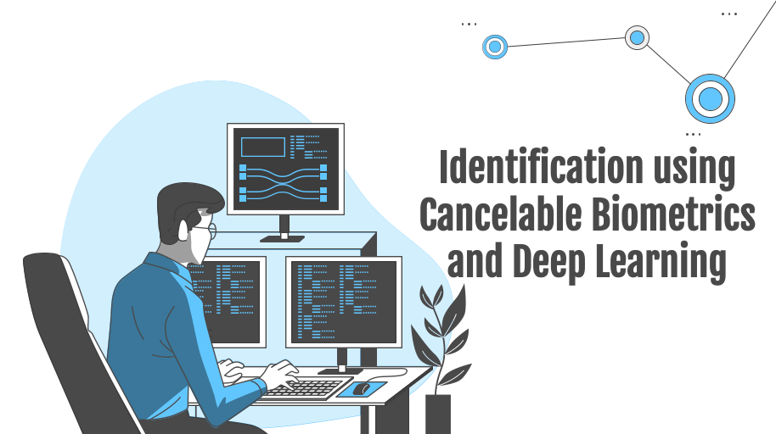
Background Information & Related Work contains a :
Background Information
Related Work
Proposed & Similar System Compairsonsn

Slide 13
Physical Biometrics
Physical biometrics refers to physiological features on the human body that can serve as identification, analyze data such as facial features, eye structure (retina or iris), finger parameters. Physical biometrics have become widespread, for example, access control to smartphones and laptops.

Slide 14
Physical measurements
face recognition technique is applications that identify or verify a person automatically from a digital image or a video frame from a video source.
Facial metric technology relies on the manufacture of the specific face recognition feature, such as the position of eyes, nose and mouth, and distances between these features.
Iris recognition or iris scanning is the process of using visible and near-infrared light to take a high-contrast photograph of a person's iris
Fingerprint recognition allows a person to be verified or identified through the analysis and comparison of his or her finger dermal ridges.

Slide 15
Behavioral Biometrics
Is the field of study related to the measure of uniquely identifying and measurable patterns in human activities in a person so the algorithm can identify the person by their behavioral pattern.

Slide 16
Behavioral measurements
The signature recognition is based on the dynamics of making the signature, rather than a direct comparison of the signature itself afterwards. The dynamic is measured as a mean of the pressure, direction, acceleration and the length of the strikes, and dynamic number of strokes and their duration
Typing Recognition , The use of the unique characteristics of a person’s typing for establishing identity.
Gait recognition , The use of an individual’s walking style or gait to determine identity

Slide 17
Cancelable Biometrics

Slide 18
Cancelable Biometrics Templates
Cancelable Biometrics Definition
is a way in which to incorporate protection and the replacement
features into biometrics to create a more secure system.
In these methods, a function that is dependent on some parameter is used to generate protected biometric templates. The parameter of the function is used as the key

Slide 19
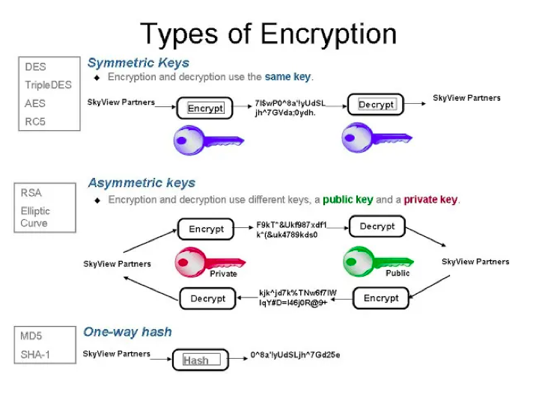
Cryptography based methods
is associated with the process of converting ordinary plain text into unintelligible text and vice-versa.
Cryptography not only protects data from theft or alteration but can also be used for user authentication
$20K
Cryptographic Techniques
10%
45K

Slide 20
cryptography concerns
Confidentiality
Information cannot be understood by anyone
Integrity
Information cannot be altered.
Non-repudiation
Sender cannot deny the intentions in the transmission of the information
Authentication
Sender and receiver can confirm each Cryptography

Slide 21
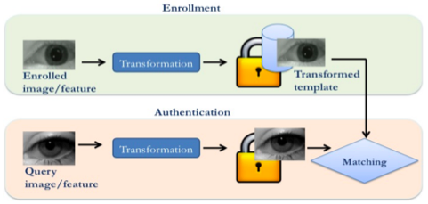
Transformation based methods
the original Biometric templates are morphed by applying Different transformations
the minutiae positions are measured in rectangular coordinates with reference to the position of the singular point by aligning x-axis with its orientation
The transformation causes changes in the cell positions. In Polar transformation, the minutiae positions are measured in the polar coordinate with reference to the core position
$20K
10%
45K

Slide 22
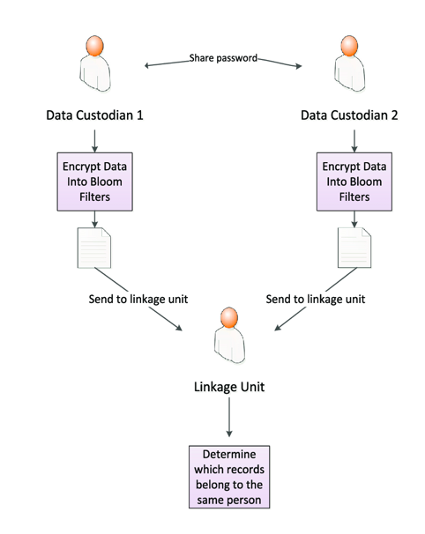
Filter based methods
Cancelable Biometric Filter is a Convolution based method. Bloom Filters is a space efficient probabilistic data structure representing a set to support membership queries. Bloom filter-based transformation of any binary feature vector generates irreversible Cancelable Biometric templates.
$20K
10%
45K

Slide 23
Machine & Deep Learning

Slide 24
Deep Learning
is the use of neural networks with many hidden layers and raw data as inputs.
Machine Learning
is the practice of programming computers to learn from data. we can use machine learning to solve problems that are very complex for non-machine learning software. There are different types of system of machine learning
There are different types of system of machine learning :
Supervised and Unsupervised

Slide 25
Supervised
this type of the data that you feed in the algorithm with the desired solution are referred to as labels
Multilayer Perceptron (MLP):
Recurrent Neural Network (RNN):
01
02
RNN is a logical choice if the input data is ordered sequentially, RNNs are capable of handling long-range temporal dependencies
Multilayer perceptron holds many hidden layers
Convolutional Neural Network (CNN):
03
The CNN has an excellent performance in machine learning problems. Specially the applications that deal with image data

Slide 26
Unsupervised
In this type you can guess that the data is unlabeled. And the most important unsupervised algorithms are Clustering, Association rule learning and Visualization and dimensionality reduction.
Online Learning:
01
this type can learn incrementally by providing the system with all the available data as instances groups or individually.
AutoEncoder:
02
learns how to efficiently compress and encode data then learns how to reconstruct the data back from the reduced encoded representation

Slide 27
Deep Learning for :
Facial recognition is one of the most prominent biometric techniques used for identity authentication and verification, it is the identification of an individual based on the photograph of their face. Deep learning methods, in the recent past, have had great success in the tasks of image recognition and classification.
Fingerprint recognition refers to the identification of an individual based on the comparison of two fingerprints. Also it fingerprint recognition has had significant improvement over its former iterations.

Slide 28
Related Work

Slide 29
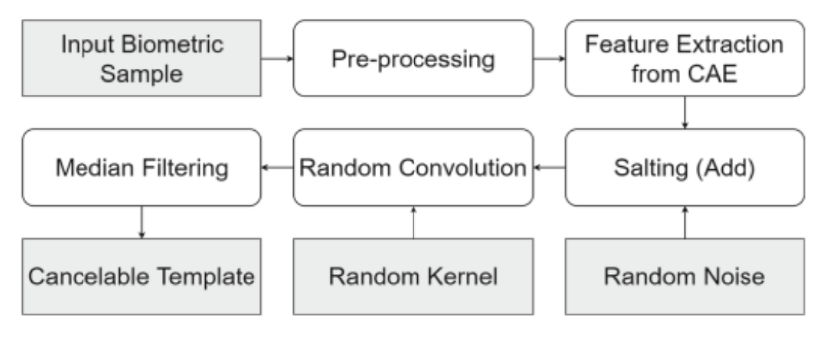
Convolutional Autoencoder:
It’s a tool for extracting features from images and compressing it to a lower dimension called latent space that generated from input images, also it is used for random noise and random convolution. The random noise is extracted features which are random noise followed by median filtering to get non-invertible templates . Also Random convolution is based transformations make use of random kernels to convolve the biometric image or features to generate cancelable templates.
Day 1

Slide 30
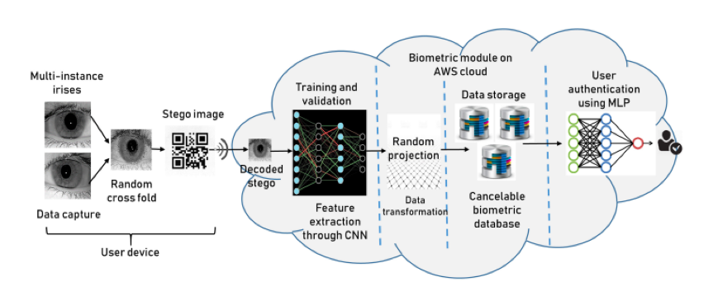
Cancelable Biometrics Using Deep Learning as a Cloud Service:
Cloud computing is a technique or a tool that allows you to store your sensitive data on a logical could know as a remote database. If an electronic device has access to the web, it has access to the data and the software programs to run it. But here it had been developed by using cancelable Biometrics and Deep Learning to make your sensitive data that stored on the cloud more secure and safe.
Day 1

Slide 31
Proposed and Similar Systems comparison
 | Our system | System using fingerprint | System using face recognition
Solved problem | High security | Forgetting password | Forgetting password
Advantage | Strong and accurate model | Unique for per person | Can not be stolen easily
Limitations | - | Low security | Low accuracy

Slide 32
03
System Analysis

Slide 33
System Analysis contains a :
System Requirements
Use Case Diagram
Functional and nonfunctional Requirements

Slide 34
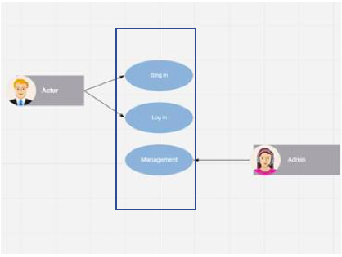
Requirements specification
In this project, we will develop a system for personal identification based on cancelable biometrics combined with deep learning. This system will be used to access remotely to a bank by using biometrics which are better than using a password
Use Case Diagram
The general architecture of our system

Slide 35
Functional Requirements
The Functional Requirements of the system explain the specific functions to be performed or accomplished by the system. We have three main functions:
Enrollment (sign up)
System Management
Personal Identification (Sign in)
Non-functional Requirements
Availability
Security
Reliability
Efficiency (fast response)

Slide 36
04
System Design

Slide 37
System Design contains a :
System Architecture
System Interfaces

Slide 38
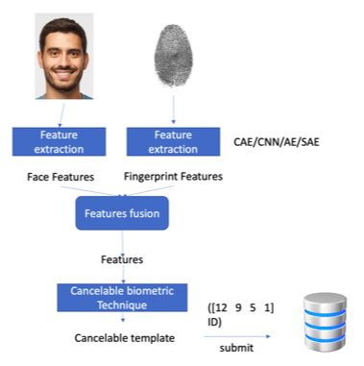
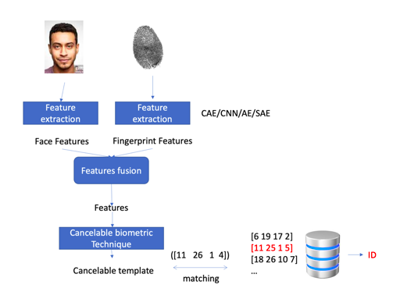
System Architecture
Enrollment Phase (Sign up):
Identification Phase (Sign in):

Slide 39
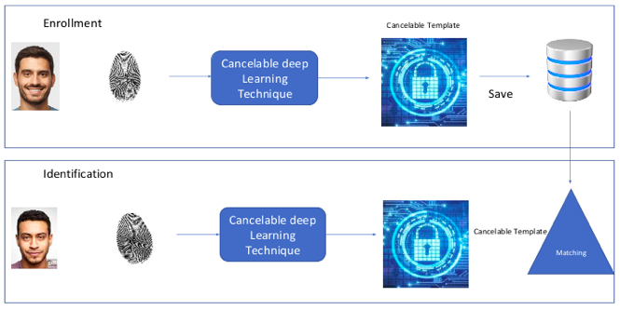
System Architecture
proposed System :

Slide 40
System Interface :
Main interface:
This is the main interface , when the user click
or tap the application icon ,this interface will
pop-up . The user has two choices sign in if the
user has an account or sign up to create
an account.

Slide 41
System Interface :
Sign up interface:
When the user tap or click on sign up
to create an account this interface will pop up.
And to sign up the user should enter the Email,
Name, Face ID , and Fingerprint .
After that user will click or tap sign up button
the System will save the new User information.

Slide 42
System Interface :
Signing in interface:
When user click or tap on sign in this interface
Will pop up and in order for the user to sign in
The system require Face ID and finger print
of the user so the system can match them
in the database and confirm the user.
If the entered Biometrics matches what is saved
in the data base the user shall enter his account
if not then the system will deny the user

Slide 43
References
[1] RecFaces. 2020. Two Main Types of Biometrics: Physical vs. Behavioral Biometrics | RecFaces. [online] Available at: <https://recfaces.com/articles/types-of-biometrics> [Accessed 1 December 2021].
[2] Verizon. 2019 Data Breach Investigations Report. Accessed: Dec. 2019.
[Online]. Available: https://enterprise.verizon.com/resources/reports/dbir/
[3] S. Barra, K.-K. R. Choo, M. Nappi, A. Castiglione, F. Narducci, and
R. Ranjan, ‘‘Biometrics-as-a-service: Cloud-based technology, systems,
and applications,’’ IEEE Cloud Comput., vol. 5, no. 4, pp. 33–37,
Jul./Aug. 2018.
[4] K. Bailey and K. Curran, ‘‘An evaluation of image based steganography
methods,’’ Multimedia Tools Appl., vol. 30, no. 1, pp. 55–88, Jul. 2006.
[5] A. Kumar and K. Pooja, ‘‘Steganography—A data hiding technique,’’ Int.
J. Comput. Appl., vol. 9, no. 7, pp. 19–23, Nov. 2010.
[6] E. Abdellatef, N. Ismail, S. Abd Elrahman, K. Ismail, M. Rihan and F. Abd El-Samie, "Cancelable multi-biometric recognition system based on deep learning", 2021. .
[7] S. K. Singh, P. Roy, B. Raman, and P. Nagabhushan, Copmuter Vision and image processing 5th International Conference CVIP 2020. Prayagrai, India, December 4-6, 2020, revised selected papers, part I, Singapore: Spriager Singapore. 2021.

